Slide 1

PROJECT REPORT
ON
RATING PREDICTION
SUBMITTED BY
Nimesh Kumar Roy

Slide 2


INTRODUCTION
We have a client who has a website where people write different reviews for technical products. Now they are adding a new feature to their website i.e. The reviewer will have to add stars(rating) as well with the review. The rating is out 5 stars and it only has 5 options available 1 star, 2 stars,
3 stars, 4 stars, 5 stars. Now they want to predict ratings for the reviews which were written in the
past and they don’t have a rating. So, we have to build an application which can predict the rating
by seeing the review.

Slide 3
1
DATA COLLECTION

Slide 4



DATA COLLECTION
The data is collected from amazon.in and fiipkart.in. We collect the reviews and ratings of one plus and redmi phones .
We have 30000 rows of data. Data has reviews and ratings (1,2,3,4,5).Data has 4 features
product,review,rating,profile_name.
FATCHING
THE REQUIRED
PAGE
GET THE
NECESSARY
DATA
SAVE THE
DATA IN
EXCEL FORMAT

Slide 5
DATA DESCRIPTION
1 RATING
1848
2 RATING
2088
3 RATING
4172
4 RATING
8537
5 RATING
13967

Slide 6
2
STEPS FOLLOWED

Slide 7
DATA
PREPROCESS
TRAIN
MODEL
EVALUATE
MODEL
DATA PREPROCESS
TRAIN MODEL
EVALUATE MODEL
IN THIS STEP WE CLEAN THE DATA ACCORDING TO TRAIN THE MODEL.WE TAKE THE VARIOUS STEP TO CLEAN THE DATA.
IN THIS STEP WE SPLIT THE DATA INTO TRAINING AND TEST DATA.IN THIS CASE IT IS 80-20.
WE CHECK PERFORMANCE OF THE MODEL ACCORDING TO THE RESULT OF EVALUATION METRIX.

Slide 8
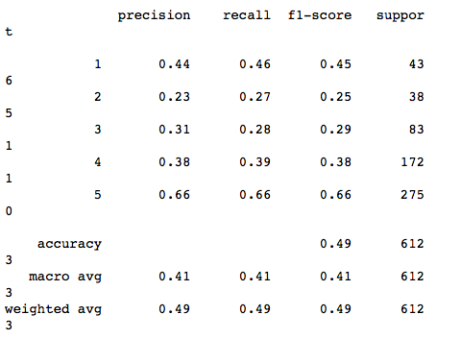
EVALUATION METRIX
Please add text here, according to the need to adjust the font and font size, recommended justified form.

Slide 9
3
PREDICTIONS

Slide 10
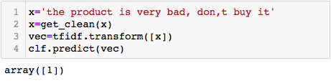
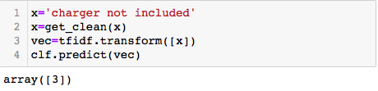
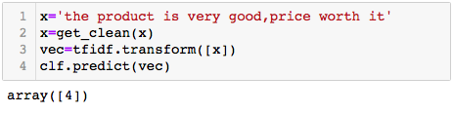
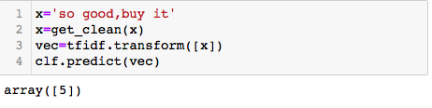
Predict Rating 1
Predict rating 3
Predict rating 4
Predict rating 5

Slide 11
THANK YOU
Please add your company name or name here

